Slide 1

Plotting – Part 1
Basic 2-D plots
Modifying the appearance
Plotting – Part 2
Plotting a function
Plotting multiple things
in one window
Plotting – Part 3
Polar plots
Animated plots
Bar graphs
by
First Year Engineering Learning Center
College of Engineering

Slide 2
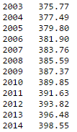
Creating a standard plot:
Here is some data we’d like to plot: the average annual concentration of atmospheric CO₂ over one decade at the Mauna Loa Observatory¹. Values in ppm.
>> years = 2003:2014;
>> co2 = [375.77, 377.49, 379.80, 381.90, 383.76, 385.59, 387.37, 389.85, 391.63, 393.82, 396.48, 398.55];
After this, the workspace should show that both arrays, years and co2, are 1 (row) × 12 (column) arrays.
>> plot(years, co2)
array of x-values then array of corresponding y-values
1. Data from NOAA at ftp://aftp.cmdl.noaa.gov/products/trends/co2/co2_annmean_mlo.txt

Slide 3
2 common errors:
The default plot style is blue line segments connecting the x / y data points. If there is only one x-value and one y-value, there is no visible line segment! If the values are not in order, the plot is very messy!
>> one_x = 55;
>> one_y = 30;
>> plot(one_x, one_y)
The figure shows a blank graph (though with axes near [55,30]).
>> disordered_x = rand(1,50);
>> disordered_y = rand(1,50);
>> plot(disordered_x, disordered_y)
(50 random numbers)
A solution is to plot the data point(s), not line segments.

Slide 4
Changing a plot’s appearance:
Commonly-used modifiers for the color, line style, and marker style can be placed as a string after the x / y arrays. Use doc plot to see options!
>> plot(years, co2, 'r')
>> plot(years, co2, 'm--')
>> plot(years, co2, 'c*')
>> plot(years, co2, 'k:d')
>> plot(years, co2, 'k:d', 'linewidth', 2, 'markersize', 12)
Less-common modifiers are entered as property/value pairs. Note that the property is entered in single quotes (i.e., a string). Use doc plot to see options!
>> xlabel('Year')
>> ylabel('CO_2 conc. [ppm]')
>> axis([2003 2015 370 410])
>> title ('Average annual concentration of CO_2 in the atmosphere')

Slide 5
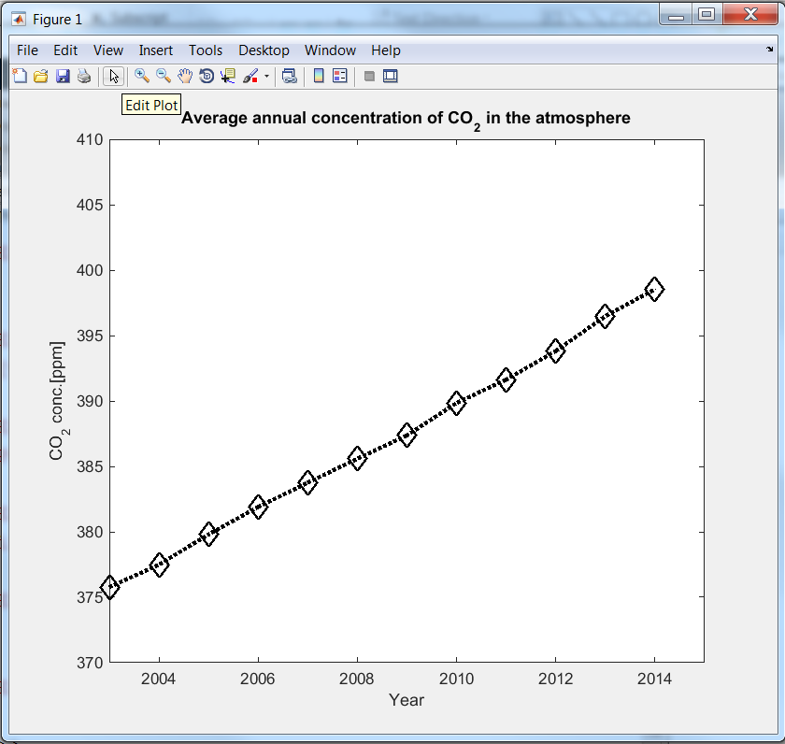
Using the plot editor:
Edit and Insert menus can add or format titles, legends, text labels, and other features.
Arrow button turns on plot edit mode. In this mode, click on a plot item to format it.
To use this figure in another document, copy it to the clipboard (under Edit menu) or save as a picture (under File menu).

Slide 6
Topics
Two ways to plot a simply defined 2-variable equation
Plotting a parametric equation
Plotting multiple things with one plot command
Hold on / hold off
Subplots

Slide 7
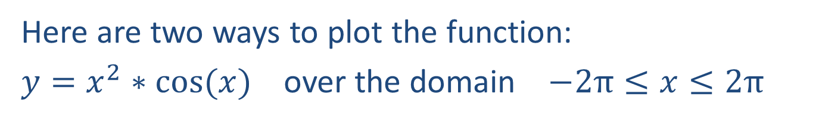
Plotting a function:
Here are two ways to plot the function:
$y=x^{2}∗cos⁡(x)$ over the domain $−2π≤x≤2π$
>> clear x;
>> fplot('x^2*cos(x)', [-2*pi 2*pi])
Use fplot() to quickly plot a function of one variable within specified limits. The variable can be any single letter, but there can be no active variable with that name in the workspace.
>> x = -2*pi:0.01:2*pi;
>> y = x.^2.*cos(x);
>> plot(x,y)
Or, create an array of x values, calculate the corresponding y values, and then plot x vs y. Note the use of element-by-element math (.^ and .*) instead of matrix math!

Slide 8
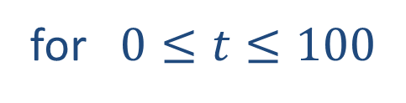
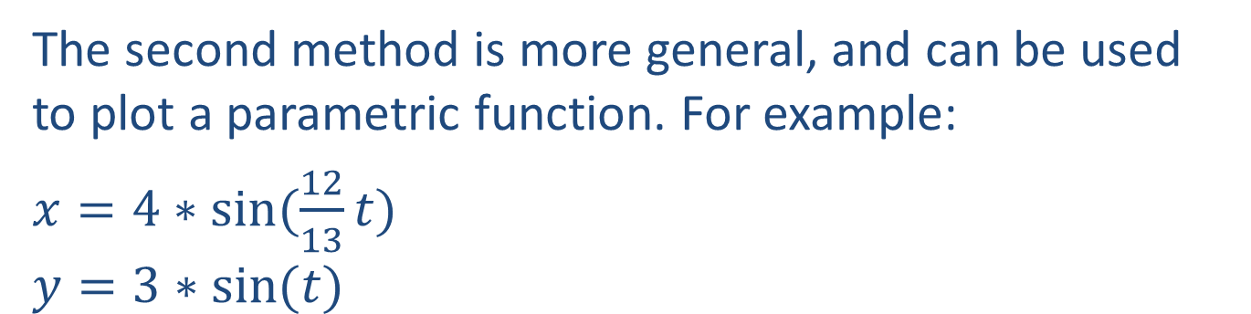
Plotting a function:
The second method is more general, and can be used to plot a parametric function. For example:
$x=4∗sin⁡(\frac{12}{13}t)$
$$y=3∗sin⁡(t)$$
for $0≤t≤100$
>> t = 0:0.01:100;
>> x = 4*sin((12/13)*t);
>> y = 3*sin(t);
>> plot(x,y)

Slide 9
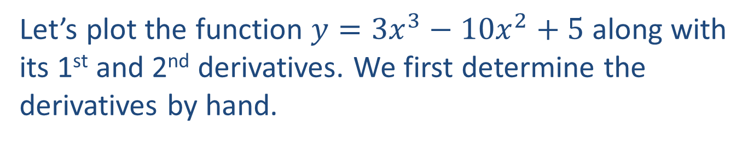
Plotting multiple things:
Let’s plot the function $y={3x}^{3}−{10x}^{2}+5$ along with its 1st and 2nd derivatives. We first determine the derivatives by hand.
>> x = -2:0.01:4;
>> y = 3*x.^3 - 10*x.^2 + 5;
>> dydx = 9*x.^2 - 20*x;
>> d2ydx2 = 18*x - 20;
>> plot(x, y, 'k', x, dydx, 'b--', x, d2ydx2, 'r:')
Defining one set of x values, then calculating the corresponding y, dy/dx, and d²y/dx² values.
Create multiple plots on one graph by adding multiple sets of x-values, y-values, and (if desired) line modifiers.

Slide 10
Plotting multiple things:
Two other ways to plot multiple things:
>> clf
>> hold on
>> plot(x, y, 'k')
>> plot(x, dydx, 'b--')
>> plot(x, d2ydx2, 'r:')
>> hold off
gives you a blank plot window
hold on makes all subsequent plot() commands add to the current plot window, and hold off ends this mode.
>> subplot(2,2,1)
>> plot(x, y, 'k')
>> subplot(2,2,2)
>> plot(x, dydx, 'b--')
>> subplot(2,2,3)
>> plot(x, d2ydx2, 'r:')
subplot(m,n,p) makes the subsequent plot() command draw in subplot p of an m x n rectangle of subplots.

Slide 11
Some special 2-D plots:
>> theta = 0:0.01:4*pi;
>> r = cos(theta).*(4*sin(theta).^2-1);
>> polar(theta,r)
polar() is the same as plot(), but interprets the datapoints as θ / r instead of x / y
>> x = linspace(0, 8*pi, 300);
>> y = x.*cos(x);
>> comet(x,y)
comet() is the same as plot(), but animates the drawing of the data

Slide 12
Other kinds of graphs:
>> x = 1900:10:2000;
>> y = [75 91 105 123.5 131 150 179 203 226 249 281.5];
>> bar(x,y)
>> z = [10 30 15 3 18];
>> pie(z)
a 1×50 array of random numbers with average of 70 and standard deviation of 10
>> final_grades = 70+10*randn(1,50);
>> hist(final_grades);
A histogram is a bar graph showing a count of how many data points fall within a each range of values

